Slide 1


BMB3015 ARTIFICIAL INTELLIGENCE
INFORMED SEARCH

Slide 2
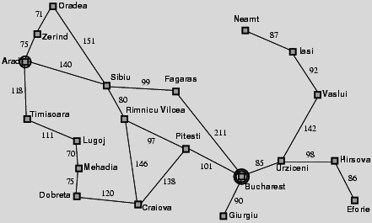
Holiday in Romania Problem

Slide 3
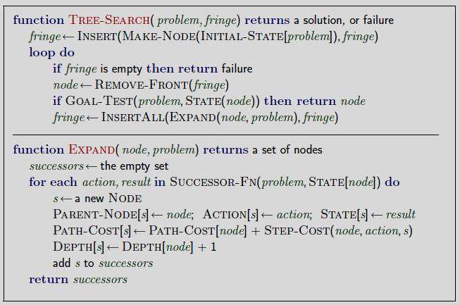
Reminder: Tree Search

Slide 4
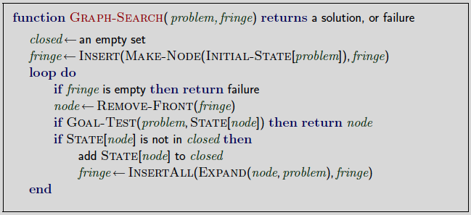
Reminder: Graph Search
Solution to exponential problems due to revisited nodes

Slide 5
Online versus Offline Search
Tree search is an offline problem solving method
solution executed with eyes closed.
Online problem solving involves acting without complete knowledge.

Slide 6
Informed Search Methods
Use information about the domain to get directed to the goal
Also known as heuristics-based search methods
Informed search
Best-first search
Greedy best-first search
A* search
Local search
Hill climbing
Simulated annealing
Local beam search
Genetic algorithms

Slide 7
Dynamic Programming
Evaluates current cost of the state and uses some heuristics to reach the goal state.
General strategy is to expand the node with the best evaluation value or the least cost.
Decisions at each time step depend on the solution to the previous subproblems.
Final solution is obtained using backtracing.
Alleviates exponential complexities of uninformed search algorithms.

Slide 8
Best-First Search
Idea: use an evaluation function f(n) for each node
estimate of "desirability"
expand most desirable unexpanded node
Implementation:
Order the nodes in fringe in decreasing order of desirability
Special cases
Greedy best-first search
A* search

Slide 9
Evaluation Function f(n)
Remember uniform cost search (UCS)
f(n) = g(n)
f(n) is evaluation function
to decide which node to expand next
g(n) is cost function
gives the path cost up to node n
Greedy best-first search
f(n) = h(n)
h(n) is heuristic function
gives estimated cost from node n to goal
A* search
f(n) = g(n) + h(n)

Slide 10
Estimate of Goal Distance

Slide 11
Heuristics
Heuristics (heuristic rules, heuristic methods)
strictly restricts the search of a solution using a rule, strategy, trick, simplification, or another element
when state-space of a problem is very large.
«Fagenbaum and Fieldman»
Properties of a good heuristic function
never overestimates (abartmayan)
optimistic (iyimser)
admissible (makul)
Notes:
Sezgisellik (sezgisel kurallar, sezgisel yöntem) problemin durum uzayı çok büyük olduğunda, çözümün aranmasını kesin biçimde sınırlayan herhangi bir kural, strateji, hile, sadeleştirme ve diğer etmenlerin kullanımıdır. (Fagenbaum ve Fieldman)

Slide 12
Heuristic Function vs Cost Function
Heuristic function is not additive as g(n)
Must be estimated separately for each node state
Trying to minimize g(n)
keeps the path short
Trying to minimize h(n)
focuses on the goal
If h(n)< true cost, then A* can find the optimal path.

Slide 13
Greedy Best-First Search
Expands the node that appears to be closest to the goal
Evaluation function is the heuristic function
f(n) = h(n)
means estimate of cost from n to goal
For holiday in Romania problem,
e.g., h (n) = straight-line distance from n to Bucharest

Slide 14
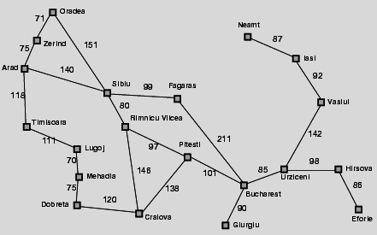
Romania with Straight-Line Distances
Straight-line distances to Bucharest
Arad | 366
Bucharest | 0
Craiova | 160
Dobreta | 242
Eforie | 161
Fagaras | 176
Giurgiu | 77
Hirsova | 151
Iasi | 226
Lugoj | 244
Mehadia | 241
Neamt | 234
Oradea | 380
Pitesti | 100
Rimnicu Vilcea | 193
Sibiu | 253
Timisoara | 329
Urziceni | 80
Vaslui | 199
Zerind | 374
h(n) is the straight line distance between a city and the Bucharest

Slide 15
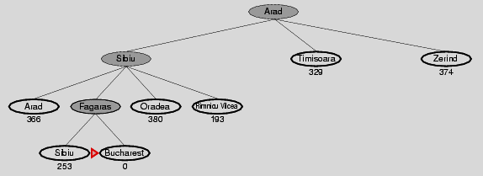

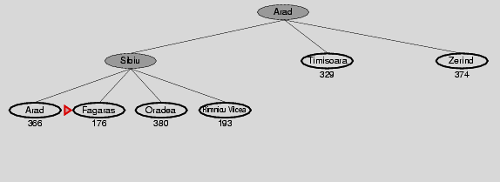
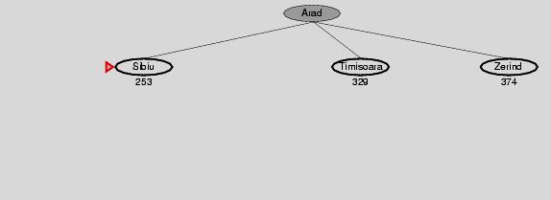
Holiday in Romania: Greedy Best-First Search
Optimal solution
Greedy best first search solution

Slide 16
Greedy Best-First Search
Complete? No – can get stuck in loops,
Resembles DFS since it prefers to follow a single path on the way to the goal
e.g., Iasi to Fagaras problem:
Iasi → Neamt → Iasi → Neamt → …
Complete in finite space with repeated-state checking
Time? O(b^{m})
but a good heuristic can give dramatic improvement
Space? O(b^{m}), keeps all nodes in memory
Optimal? No

Slide 17
A* Search
Idea:
avoid expanding paths that are already expensive
Evaluation function f(n) = g(n) + h(n)
g(n) = cost so far to reach n
h(n) = estimated cost from n to goal
f(n) = estimated total cost of path through n to goal

Slide 18
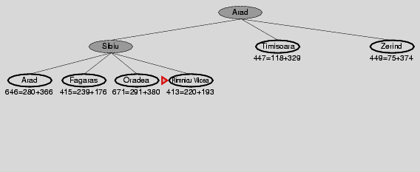
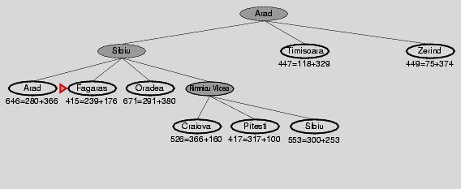
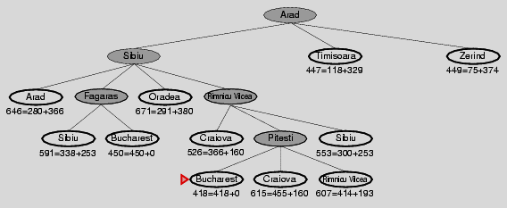
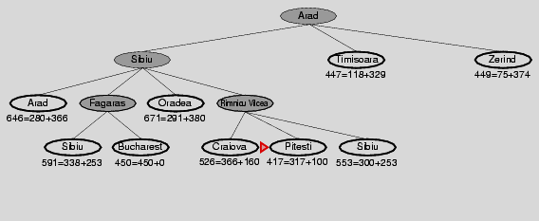
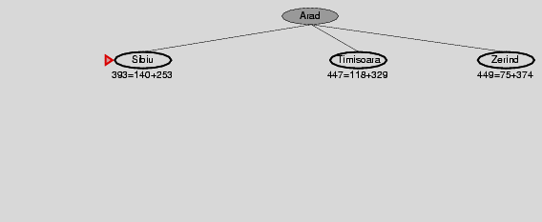

Holiday in Romania: A* search
Optimal solution

Slide 19
A* Search
Complete? Yes
unless there are infinitely many nodes with f ≤ f(G)
Time? Exponential
Space? Keeps all nodes in memory Optimal? Yes, cannot expand f_{i+1} until f_{i} is finished
If C* is the cost of the optimal solution
A* expands all nodes with f(n) < C*
A* expands some nodes with f(n) = C*
A* expands no nodes with f(n) > C*

Slide 20
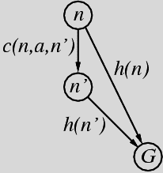
Consistent Heuristics
A heuristic is consistent if for every node n, every successor n' of n generated by any action a,
h(n) ≤ c(n,a,n') + h(n')
If h is consistent, we have
[f(n') = g(n') + h(n') = g(n) + c(n,a,n') + h(n') ]
≥ [g(n) + h(n) = f(n)]
i.e., f(n) is non-decreasing along any path.
Theorem: If h(n) is consistent,
A* using GRAPH-SEARCH is optimal

Slide 21
Admissible Heuristics
A heuristic h(n) is admissible if for every node n,
h(n) ≤ h*(n)
where h*(n) is the true cost to reach the goal state from n
An admissible heuristic never overestimates the cost to reach the goal,
i.e., it is optimistic
For example, h(n) of straight line distance never overestimates the actual road distance

Slide 22
Dominance
If h₂(n) ≥ h₁(n) for all n (both admissible)
then h₂ dominates h₁
h₂ is better for search
Typical search costs (average number of nodes expanded):
d=12
Iterative Deepening Search (IDS) = 3,644,035 nodes A*(h₁) = 227 nodes A*(h₂) = 73 nodes
d=24
IDS = too many nodes A*(h₁) = 39,135 nodes A*(h₂) = 1,641 nodes

Slide 23
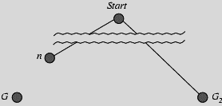
Optimality of A*
Suppose some suboptimal goal G₂ has been generated and is in the fringe.
Let n be an unexpanded node in the fringe such that n is on a shortest path to an optimal goal G.
f(G₂) = g(G₂) since h(G₂) = 0
f(G) = g(G) since h(G) = 0
g(G₂) > g(G) since G₂ is suboptimal
f(G₂) > f(G) since G₂ is suboptimal

Slide 24
Optimality of A*
Suppose some suboptimal goal G₂ has been generated and is in the fringe.
Let n be an unexpanded node in the fringe such that n is on a shortest path to an optimal goal G.
f(G₂) > f(G) since G₂ is suboptimal
h(n) ≤ h*(n) since h is admissible
g(n) + h(n) ≤ g(n) + h*(n)
f(n) ≤ f(G)
Hence f(G₂) > f(n), and A* will never select G₂ for expansion
Notes:
h*(n) = true cost of getting from n to goal

Slide 25
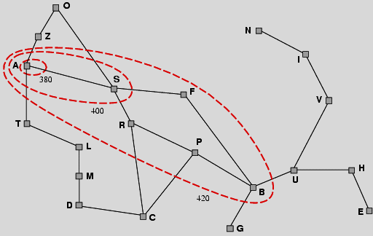
Optimality of A*
A* expands nodes in the order of increasing f value
Gradually adds "f-contours" of nodes
Contour i has all nodes with f=f_{i} , where f_{i} < f_{i+1}

Slide 26
Relaxed Problems
A problem with fewer restrictions on the actions is called a relaxed problem
The cost of an optimal solution to a relaxed problem is an admissible heuristic for the original problem
How to obtain a good heuristic function?
Define the rules of a problem
Cross out the part of the rules and define a relaxed problem
Find heuristics that never overestimate in this way
Notes:
• Key point: the optimal solution cost of a relaxed problem is no greater than the optimal solution cost of the real problem

Slide 27
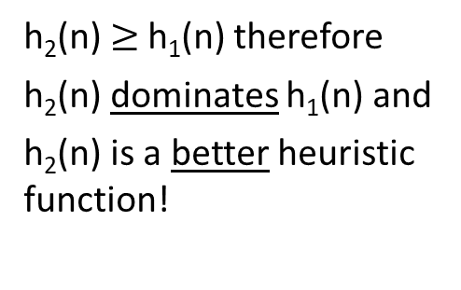
Obtaining a Heuristic Function: 8-Puzzle
Rule 1: Move a block from A to B if B is adjacent to A
Rule 2: Move a block from A to B if B is blank
Crossing Rule 1 out
if a block is in right position or not
h₁(n) = number of blocks that are misplaced
Crossing Rule 2 out
distance of block to right position
h₂(n) = sum of distances of block to the right position
h₂(n) $≥$h₁(n) therefore
h₂(n) dominates h₁(n) and
h₂(n) is a better heuristic function!
h₁(n) = 8
1 | 8 | 6
7 | 2
4 | 3 | 5
 | 1 | 2
3 | 4 | 5
6 | 7 | 8
h₂(n) = 1+3+4+2+2
+2+2+1 =17

Slide 28
LOCAL SEARCH
In many optimization problems
the path to the goal is irrelevant
the goal state itself is the solution
State space = set of "complete" configurations
find optimal configuration, e.g. travelling salesman problem (TSP)
find configuration satisfying constraints, e.g. N-queens
In such cases, local search (iterative improvement) algorithms are useful
keep a single "current" state, try to improve it
Requires constant storage space
suitable for online as well as offline search

Slide 29
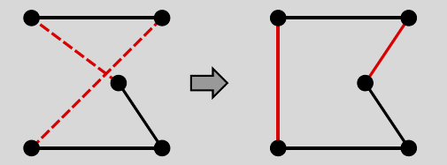
Example 1: Travelling Salesman Problem
Find the shortest tour visiting all cities exactly once
Start with any complete tour, perform pairwise exchanges
Variants of local search get within 1% of optimal very quickly with thousands of cities
Notes:
Well-known example: travelling salesperson problem (TSP)
Minimum spanning tree can be computed in O(n2)
and is a lower bound on the shortest (open) tour
TSP problemi
Şehirler arası bir rota bulmak
Rota her şehirden geçmeli
Toplam gidilen yol minimum olmalı

Slide 30
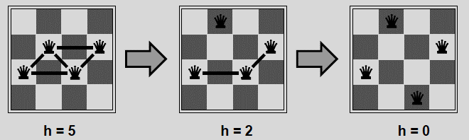
Example 2: N-Queens
Rules:
Put n queens on an n × n board
no two queens can be on the same row, column, or diagonal
Move a queen to reduce the number of conflicts
Local search usually solves n-queens problems almost instantaneously for very large n, e.g., n=1 million

Slide 31
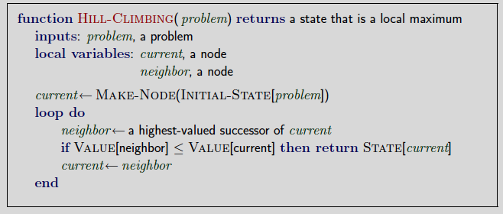
Hill-Climbing Search
Like climbing Everest in thick fog with amnesia
Stores only current state
Idea is to act towards the most improving state
Notes:
Yoğun bir siste, hafıza kaybına uğramış birinin Everest Dağına tırmanmasına benzer. Sadece etkin durumun bilgisini tutar.
Ana düşünce : Her zaman, şimdiki durumu en fazla geliştiren yönde adım at.
Best-first Search’e benzemektedir.
Yaylada ve sıralı tepelerde şaşabilir.
Tepe Tırmanmanın Problemleri
İlk duruma bağlı
Lokal maksimum, plato ve sırtlara takılabilir

Slide 32
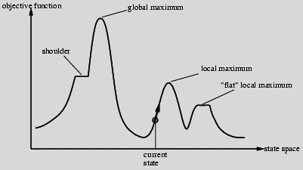
Hill-Climbing Search Problem
Depending on initial state, can get stuck in local maxima, i.e: foothill or plateau
Random restarts
Taking bigger steps
Therefore, point reached by hill-climbing may be maximal but not maximum.
Solutions?
Notes:
Local Optima (Foothill (Dağın uzantısı olan tepeler) Problem)
• Problem Definition
– Point reached by hill-climbing may be maximal but not maximum
– Maximal
• Definition: not dominated by any neighboring point (with respect to criterion measure)
– Maximum
• Definition: dominates all neighboring points (wrt criterion measure)
• Ramifications
– Steepest ascent hill-climbing will become trapped (why?)
– Need some way to break out of trap state
• Accept transition (i.e., search move) to dominated neighbor
• Start over: random restarts
Lack of Gradient (Plateau Problem)
• Problem Definition
– Function space may contain points whose neighbors are indistinguishable (with respect to criterion measure)
– Effect: “flat” search landscape
• Ramifications
– Steepest ascent hill-climbing will become trapped
– Need some way to break out of zero gradient
• Accept transition (i.e., search move) to random neighbor
• Random restarts
• Take bigger steps

Slide 33
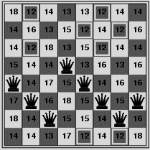
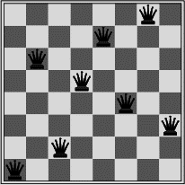
Hill-Climbing Search for N-Queens
Get stuck at a local minima in %86 of the trials for 8-queens problem
h = number of pairs of queens that are attacking each other, either directly or indirectly
h = 17 on the left, a local minima with h = 1 on the right
Notes:
8^8 = 2^24 ~ 17 milyon durum
Tepe tırmanmayı farklı başlangıçlarla tekrarlamak - Random-restart hill climbing
Benzetimli Tavlama- Simulated annealing
Paralel Tepe Tırmanma - Local beam search

Slide 34
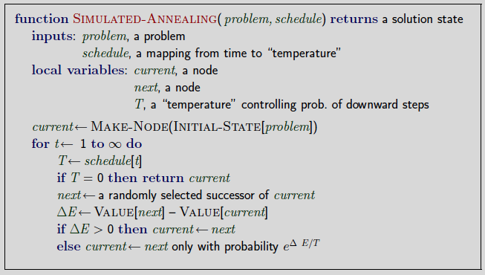
Simulated Annealing Search
Idea is to escape from local maxima by allowing some "bad" moves but gradually decrease their frequency
t: time
T: temperature
Notes:
Properties of simulated annealing search
One can prove:
If T decreases slowly enough, then simulated annealing search will find a global optimum with probability approaching 1
At fixed \temperature" T, state occupation probability reaches Boltzman distribution
T decreased slowly enough =) always reach best state x*
Is this necessarily an interesting guarantee??
Devised by Metropolis et al., 1953, for physical process modelling
Widely used in VLSI layout, airline scheduling, etc
Ana fikir : Yerel Maksimum’dan kaçmak için, istenmeyen hareketlere izin ver.
Rasgele bir hareket üret. İyileşme varsa kabul et. Yoksa azalan bir olasılıkla kabul et.
Zaman içinde rastgele hareketin boyutu ve kabul olasılığı azaltılır.

Slide 35
Simulated Annealing Search
If T decreases slowly enough, then simulated annealing search will find a global optimum with probability approaching 1
t: time
T: temperature
Notes:
Properties of simulated annealing search
One can prove:
If T decreases slowly enough, then simulated annealing search will find a global optimum with probability approaching 1
At fixed \temperature" T, state occupation probability reaches Boltzman distribution
T decreased slowly enough =) always reach best state x*
Is this necessarily an interesting guarantee??
Devised by Metropolis et al., 1953, for physical process modelling
Widely used in VLSI layout, airline scheduling, etc
Ana fikir : Yerel Maksimum’dan kaçmak için, istenmeyen hareketlere izin ver.
Rasgele bir hareket üret. İyileşme varsa kabul et. Yoksa azalan bir olasılıkla kabul et.
Zaman içinde rastgele hareketin boyutu ve kabul olasılığı azaltılır.

Slide 36
Tabu Search
Tabu search
prevents returning quickly to the same state.
Implementation
keep fixed length queue so-called «tabu list»
add most recent state to queue
drop the oldest state
Never move to a state that's currently on the tabu list.
A significant cost can be added to f(n) of the visited states
Quite powerful
competitive with simulated annealing

Slide 37
Local Beam Search
Idea is to keep track of k states rather than just one
Start with k randomly generated states
At each iteration, the successors of all k states are generated
If any one is a goal state, stop;
Else select the k best successors from the complete list and repeat.
Notes:
Ana Fikir: Tek bir durumu izlemek yerine K taneyi izle
K adet rasgele üretilmiş durumla başla
Her bir iterasyonda k durumun hepsiden gidilebilecek tüm durumları üret.
Bu durumlardan biri hedefse dur. Değilse, en iyi k tanesini mevcut durumlar olarak ata ve bir önceki adıma dön.
Idea: keep k states instead of 1; choose top k of all their successors
Not the same as k searches run in parallel!
Searches that nd good states recruit other searches to join them
Problem: quite often, all k states end up on same local hill
Idea: choose k successors randomly, biased towards good ones
Observe the close analogy to natural selection!

Slide 38
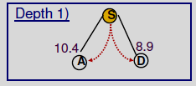
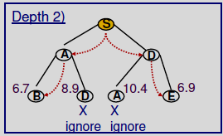
Local Beam Search
• Assume a pre-fixed width
in the example b= 2
• Perform breadthfirst, but only keep the width number of best new nodes depending on heuristic at each new level

Slide 39
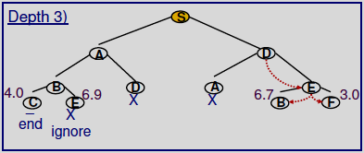
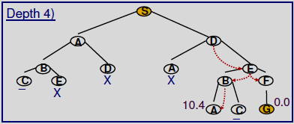
Local Beam Search
• Optimization is possible
Ignore leafs that are not goal nodes
see the node C

Slide 40
Genetic Algorithms
A successor state is generated by combining two parent states
Start with k randomly generated states (population)
A state (chromosome) is represented as a string over a finite alphabet (often a string of 0s and 1s)
Evaluation function (fitness function).
Higher values for better states.
Notes:
Genetik algoritmalar, evrim mekanizmasına (en iyinin yaşaması) dayanır.
Amaç, uygunluk fonksiyonunun (fitness function) maksimizasyon / minimizasyon optimizasyonudur.
Uygunluk fonksiyonu: Toplumdaki her kromozomun / birey / durum ne kadar iyi olduğu gösteren fonksiyondur. Büyük değer, iyi / uygun birey.
K adet rasgele üretilmiş kromozom / durum / çözüm hipotezi ile başlar. Durumlar kümesine popülasyon denir.
Kromozom / durumlar sırala ya da sırasız karakter kümeleri ile temsil edilir. Genelde sayılar ya da 0 ve 1’lardan oluşur.

Slide 41
Genetic Algorithm
Operations used to produce new chromosomes or states
selection:
Selection of chromosomes that are to be used to produce the next generation
reproduce:
Performance of crossover operation to generate new solutions
mutation:
Random change of some values of chromosomes
Notes:
Seçme (selection) :
Bir sonraki nesli üretecek kromozomların seçilmesidir.
Yeniden kopyalama (reproduce) :
Yeni çözümler üretmek için çaprazlama (crossover) işlemi yapılır.
Değiştirme (mutation) :
Kromozom’un bazı değerlerini rasgele değiştirir.

Slide 42
Genetic Algorithm
function GENETIC_ALGORITHM(population, FITNESS-FN) return an individual
input: population, a set of individuals
FITNESS-FN, a function which determines the quality of the individual
repeat
new_population ← empty set
loop for i from 1 to SIZE(population) do
x ← RANDOM_SELECTION(population, FITNESS_FN)
y ← RANDOM_SELECTION(population, FITNESS_FN)
child ← REPRODUCE(x,y)
if (small random probability)
then child ← MUTATE(child)
add child to new_population
population ← new_population
until some individual is fit enough or enough time has elapsed
return the best individual
Notes:
GA vs. Paralel Tepe Tırmanma?
Genetik algoritmalar, evrim mekanizmasına (en iyinin yaşaması) dayanır.
Amaç, uygunluk fonksiyonunun (fitness function) maksimizasyon / minimizasyon optimizasyonudur.
Uygunluk fonksiyonu: Toplumdaki her kromozomun / birey / durum ne kadar iyi olduğu gösteren fonksiyondur. Büyük değer, iyi / uygun birey.
K adet rasgele üretilmiş kromozom / durum / çözüm hipotezi ile başlar. Durumlar kümesine popülasyon denir.
Kromozom / durumlar sırala ya da sırasız karakter kümeleri ile temsil edilir. Genelde sayılar ya da 0 ve 1’lardan oluşur.
Yeni kromozom / durumların üretilmesinde kullanılan operatörler;
Seçme (selection) : Bir sonraki nesli üretecek kromozomların seçilmesidir.
Yeniden kopyalama (reproduce) : Yeni çözümler üretmek için çaprazlama (crossover) işlemi yapılır.
Değiştirme (mutation) : Kromozom’un bazı değerlerini rasgele değiştirir.
Kromozom Seçim Türleri
1. Rulet tekeri seçimi
Bireylerin (kromozomların) uygunluk değerine göre seçim.
Fakat uygunluk değeri en büyük olanın seçileceği garanti değil, seçilme şansı fazla.
Her bir kromozomun seçilme şansı, kendi uygunluk değerinin tüm bireylerin uygunluk değerlerinin toplamına oranıdır.
2. Sıralama seçimi
Rulet tekeri seçimi, uygunluklar çok farklıysa problemlere yol açar. (Örneğin, en iyi kromozomun seçilme şansı %90 ise diğer kromozomlar çok az seçilme şansına sahip)
Sıralama seçimi önce populasyonu uygunluk değerlerine göre küçükten büyüğe sıralar. Her kromozomun sıra değeri uygunluk değeri olarak atanır. En kötü 1, en iyi N. Seçilme şansı yine uygunluk değerinin toplam uygunluk değerine oranı ile bulunur.
Böylelikle bütün kromozomlara seçilme şansı verilir. Fakat bu yöntemde en iyi kromozomların seçilme şansı diğerlerinden çok farklı olmadığından çözüme yaklaşma yavaş olacaktır.
Farklı Olasılıklarla Seçim?
Seçilme şansları toplamı=100
Bir aralığı 100 parçaya böl.
Seçilme şanslarına göre parçaları kromozomlara ata.
1-100 arasında rasgele bir sayı üret.
O sayının karşı geldiği aralığın atandığı kromozomu seç.
Seçilme şansları %44.34355 şeklinde olursa?

Slide 43
Ways of Chromosome Selection I: Roulette Wheel Selection
Chromosomes are selected according to their fitness values.
The chromosome with the greatest fitness values
has only the greatest probability for being selected
but its selection is not guaranteed.
The selection probability of each chromosome is
the ratio of its fitness value to the sum of fitness values of all chromosomes in the population.
Notes:
Farklı Olasılıklarla Seçim?
Seçilme şansları toplamı=100
Bir aralığı 100 parçaya böl.
Seçilme şanslarına göre parçaları kromozomlara ata.
1-100 arasında rasgele bir sayı üret.
O sayının karşı geldiği aralığın atandığı kromozomu seç.
Seçilme şansları %44.34355 şeklinde olursa?

Slide 44
Problems of Roulette Wheel Selection
Roulette wheel selection leads to problems when fitness values are fairly different.
For example,
if the selection probability of the best chromosome is 90%
the other chromosomes have much less chance for being selected.
Notes:
Farklı Olasılıklarla Seçim?
Seçilme şansları toplamı=100
Bir aralığı 100 parçaya böl.
Seçilme şanslarına göre parçaları kromozomlara ata.
1-100 arasında rasgele bir sayı üret.
O sayının karşı geldiği aralığın atandığı kromozomu seç.
Seçilme şansları %44.34355 şeklinde olursa?

Slide 45
Ways of Chromosome Selection II: Ordered Selection
Ordered selection first sorts the population according to the fitness values in ascending order.
The order value of the chromosome is assigned as the fitness value, which is 1 and N in the worst and best cases, respectively.
Selection probability is again the ratio of a fitness value to the total fitness values in the population.
Therefore all chromosomes have the chance of being selected.
Notes:
Farklı Olasılıklarla Seçim?
Seçilme şansları toplamı=100
Bir aralığı 100 parçaya böl.
Seçilme şanslarına göre parçaları kromozomlara ata.
1-100 arasında rasgele bir sayı üret.
O sayının karşı geldiği aralığın atandığı kromozomu seç.
Seçilme şansları %44.34355 şeklinde olursa?

Slide 46
Problems of Ordered Selection
The convergence of the method to the solution would be slow.
Because the selection probability of the best chromosomes are not much different than the others.
Notes:
Farklı Olasılıklarla Seçim?
Seçilme şansları toplamı=100
Bir aralığı 100 parçaya böl.
Seçilme şanslarına göre parçaları kromozomlara ata.
1-100 arasında rasgele bir sayı üret.
O sayının karşı geldiği aralığın atandığı kromozomu seç.
Seçilme şansları %44.34355 şeklinde olursa?

Slide 47
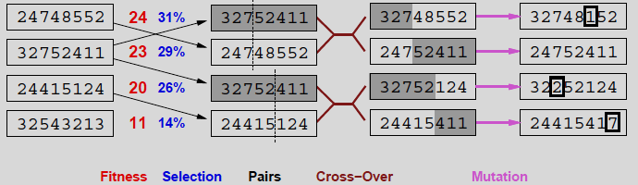
Genetic Algorithms: 8-Queens
Fitness function: number of non-attacking pairs of queens (min = 0, max = 8 × 7/2 = 28)
24/(24+23+20+11) = 31%
23/(24+23+20+11) = 29% etc.
Notes:
GAs require states encoded as strings (GPs use programs)
Crossover helps if substrings are meaningful components
8 vezirde kromozomların ifade edilmesi:
Herbir sütunda bir vezir var.
State = her bir vezirin sütündaki yeri
=> 8 x log₂(8) bits = 24 bits (ikili gösterimde)

Slide 48
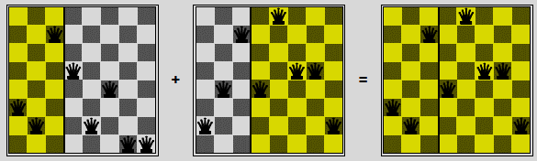
Genetic Algorithms: 8-Queens
Cross-over operation visualization

Slide 49
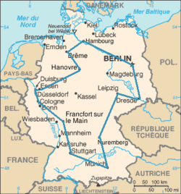
Genetic Algorithms: TSP
Let’s assume 8 ordered cities
1) Berlin 3) Stuttgart 5) Cologne 7) Dusseldorf
2) Munich 4) Wesbaden 6) Hanover 8) Breme
Probable chromosomes/ solution hypotheses
CityList1 (3 5 7 2 1 6 4 8)
CityList2 (2 5 7 6 8 1 3 4)
Standard cross over
CityList1 (3 5 7 6 8 1 3 4)
CityList2 (2 5 7 2 1 6 4 8)
Notes:
GA’nın Performansını Etkileyen Faktörler
Popülasyon büyüklüğü / Kromozom sayısı: Kromozom sayısını arttırmak çalışma zamanını arttırırken, azaltmak da kromozom çeşitliliğini yok eder.
Mutasyon Oranı: Kromozomlar birbirine benzemeye başladığında hala çözüm noktalarının uzağında bulunuyorsa mutasyon işlemi GA’nın sıkıştığı yerden (tüm kromozomlar aynı platoda) kurtulmak için tek yoludur. Ancak yüksek bir değer vermek GA’ın kararlı bir noktaya ulaşmasını engelleyecektir.
Kaç Noktalı Çaprazlama Yapılacağı: Normal olarak çaprazlama tek noktada gerçekleştirilmekle beraber yapılan araştırmalar bazı problemlerde çok noktalı çaprazlamanın çok yararlı olduğunu göstermiştir.
Çaprazlamanın sonucu elde edilen bireylerin nasıl değerlendirileceği: Elde edilen iki bireyin birden kullanılıp kullanılamayacağı.
Durum kodlanmasının nasıl yapıldığı: Bir parametrenin doğrusal yada logaritmik kodlanması GA’nın performansında önemli bir farka yol açabilir.
Başarı değerlendirmesinin nasıl yapıldığı: Akıllıca yazılmamış bir değerlendirme işlevi, çalışma zamanını uzatabileceği gibi çözüme hiçbir zaman ulaşmamasına da neden olabilir.
Değerlendirmeler
Pozitif yönleri
Crossover ve mutasyon sayesinde lokal maksimum ve platolardan kurtulabilir.
Doğa temelli
Negatif yönleri
Ayarlanabilir çok fazla parametreye sahip
Bir problemde gösterdiği başarıyı başka bir problemde tekrarlaması zor
Bazı problem türleri için iyi ama tepe tırmanmayı farklı başlangıçlarla tekrarlamaktan ya da paralel tepe tırmanmadan daha iyi olduğuna dair matematiksel bir kanıt yok.

Slide 50
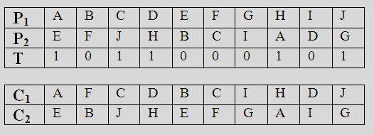
Uniform Crossover
Construct a template from random 1’s and 0’s at the length of a chromosome.
Change the locations of P1 and P2 for 0’s in the template.
Do not change the locations of P1 and P2 for 1’s in the template.
Cannot solve TSP problem

Slide 51
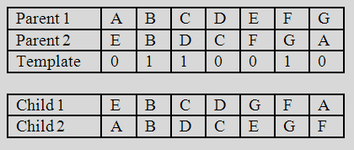
Order-based Crossover
Construct a template from random 1’s and 0’s at the length of a chromosome.
For Child1:
Take the values in Parent1 for which the indices in Template is 1. Put them at the same indices in Child1. Child1 has some spaces then.
Take the values in Parent1 for which the indices in Template is 0.
(A D E G)
Reorder the list according to their order in Parent2.
(E D G A)
Fill in the spaces of Child1 with the resulting list.
For Child2 :
Apply the same procedure
(E C F A) → (A C E F)

Slide 52
Summary
Heuristic functions
estimate costs of shortest paths
good heuristics can dramatically reduce search cost
admissible heuristics can be derived from exact solution of relaxed problems
Best-first search
is a general search where the minimum-cost nodes (according to some measure) are expanded first.
Greedy search and A* search are examples of best-first search algorithms
Greedy search
uses minimal estimated cost h(n) to the goal state as measure.
This reduces the search time, but the algorithm is neither complete nor optimal.
A* search
combines uniform-cost search and greedy search: f(n) = g(n) + h(n).
A* handles state repetitions and h(n) never overestimates.
A* is complete, optimal and optimally efficient, but its space complexity is still bad.
The time complexity depends on the quality of the heuristic function.
Iterative deepening A* and Simplified memory bounded A* reduce the memory requirements of A*.
Local Search
Used when the path to the goal is irrelevant; but the goal state itself is the solution
Hill-climbing algorithms
keep only a single state in memory, but can get stuck on local optima.
Simulated annealing
escapes local optima, and is complete and optimal given a “long enough” cooling schedule.

Slide 53
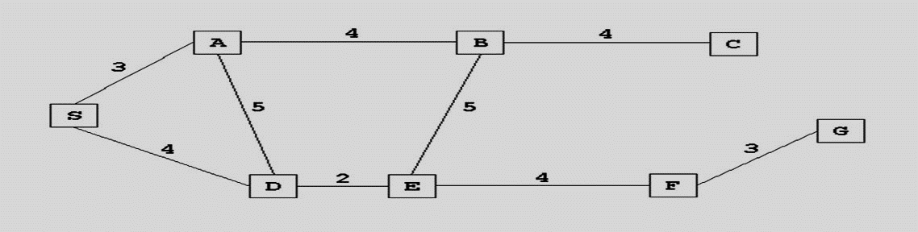
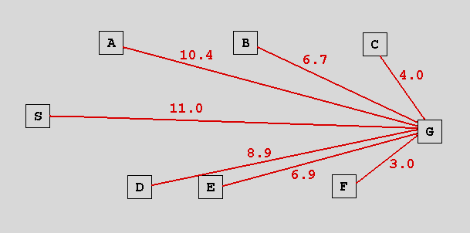
Figure 1→ Road links between different cities.
Values on links→ distance between the cities
Figure 2→ Straight-line distances of different cities to city G
Goal→ Going from city S to city G

Slide 54
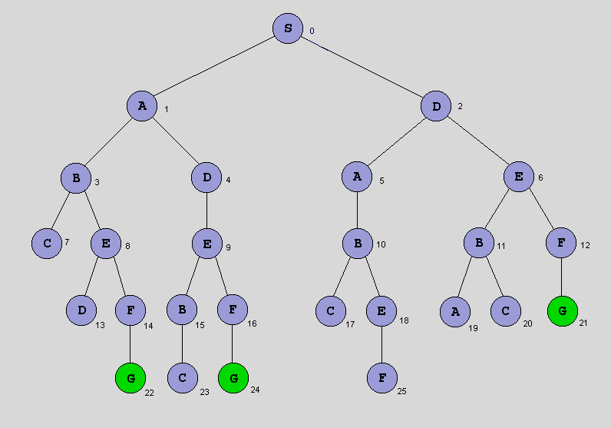
State space
Search tree

Slide 55
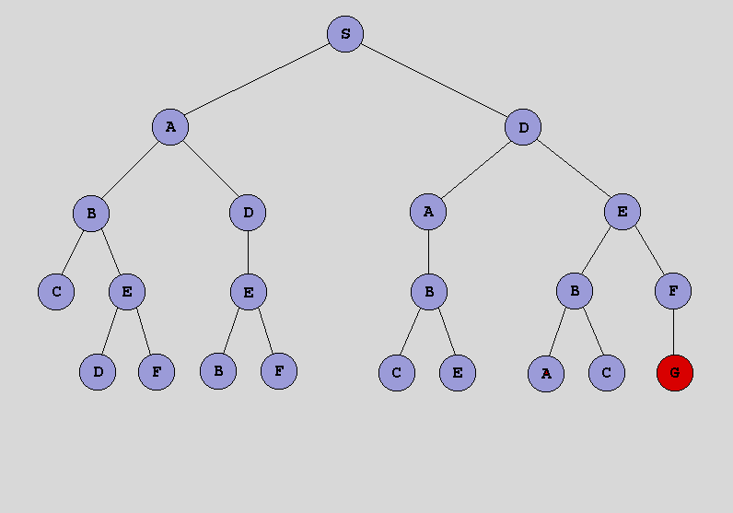
Breadth-first search
[S]
[A₁,D₂]
[D₂,B₃,D₄]
[B₃,D₄,A₅,E₆]
[D₄,A₅,E₆,C₇,E₈]
[A₅,E₆,C₇,E₈,E₉]
[E₆,C₇,E₈,E₉,B₁₀]
[C₇,E₈,E₉,B₁₀,B₁₁,F₁₂]
[E₈,E₉,B₁₀,B₁₁,F₁₂]
[E₉,B₁₀,B₁₁,F₁₂,D₁₃,F₁₄]
[B₁₀,B₁₁,F₁₂,D₁₃,F₁₄,B_{15,}F₁₆]
[B₁₁,F₁₂,D₁₃,F₁₄,B_{15,}F₁₆,C₁₇,E₁₈]
[F₁₂,D₁₃,F₁₄, B_{15,}F₁₆,C₁₇,E₁₈,A₁₉,C₂₀]
[D₁₃,F₁₄, B_{15,}F₁₆,C₁₇,E₁₈,A₁₉,C₂₀,G₂₁]
[F₁₄,B_{15,}F₁₆,C₁₇,E₁₈,A₁₉,C₂₀,G₂₁]
[B_{15,}F₁₆,C₁₇,E₁₈,A₁₉,C₂₀,G₂₁,G₂₂]
[F₁₆,C₁₇,E₁₈,A₁₉,C₂₀,G₂₁,G₂₂,C₂₃]
[C₁₇,E₁₈,A₁₉,C₂₀,G₂₁,G₂₂,C₂₃,G₂₄]
[E₁₈,A₁₉,C₂₀,G₂₁,G₂₂,C₂₃,G₂₄]
[A₁₉,C₂₀,G₂₁,G₂₂,C₂₃,G₂₄]
[C₂₀,G₂₁,G₂₂,C₂₃,G_{24,}F₂₅]
[G₂₁,G₂₂,C₂₃,G_{24,}F₂₅]
BFS={S,D,E,F,G}
Numbers under characters indicate indices.

Slide 56
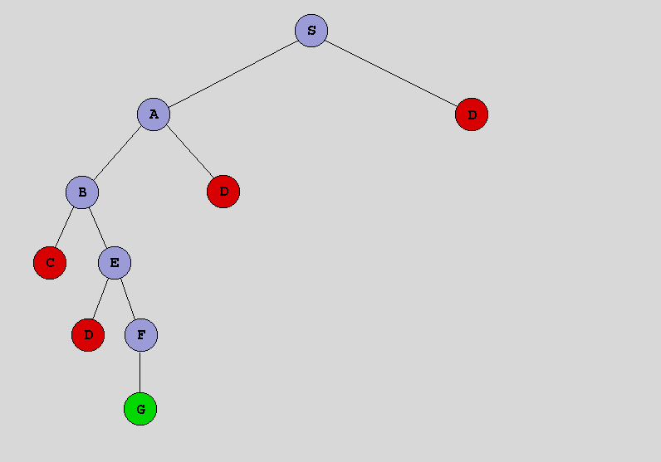
Depth-first search
[S]
[A₁,D₂]
[B₃,D₄,D₂,]
[C₇,E₈,D₄,D₂]
[E₈,D₄,D₂]
[D₁₃,F₁₄,D₄,D₂]
[F₁₄,D₄,D₂]
[G₂₂,D₄,D₂]
DFS={S,A,B,E,F,G}
Numbers under characters indicate indices.

Slide 57
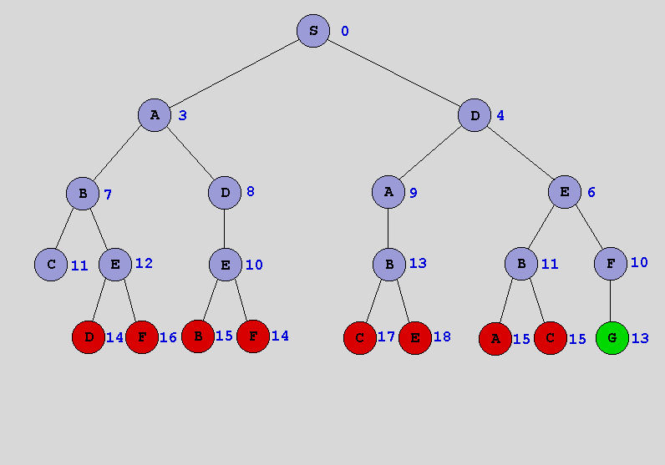
Uniform cost search
[S₀]
[A₃,D₄]
[D₄,B₇,D₈]
[E₆,B₇,D_{8,}A₉]
[B₇, D_{8,}A₉,F₁₀,B₁₁]
[D_{8,}A₉,F₁₀,B₁₁,C₁₁,E₁₂]
[A₉,F₁₀,E₁₀,B₁₁,C₁₁,E₁₂]
[F₁₀, E_{10,}B₁₁,C₁₁,E₁₂,B₁₃]
[E_{10,}B₁₁,C₁₁,E₁₂,B₁₃,G₁₃]
[B₁₁,C₁₁,E₁₂,B₁₃,G₁₃,F₁₄,B₁₅]
[C₁₁,E₁₂,B₁₃,G₁₃,F₁₄,B₁₅,A₁₅,C₁₅]
[E₁₂,B₁₃,G₁₃,F₁₄,B₁₅,A₁₅,C₁₅]
[B₁₃,G₁₃,F₁₄,D₁₄, B₁₅,A₁₅,C₁₅,F₁₆]
[G₁₃, F₁₄,D₁₄, B₁₅,A₁₅,C₁₅,F₁₆,C₁₇,E₁₈]
UCS={S,D,E,F,G}
Numbers under characters indicate distances from S.

Slide 58
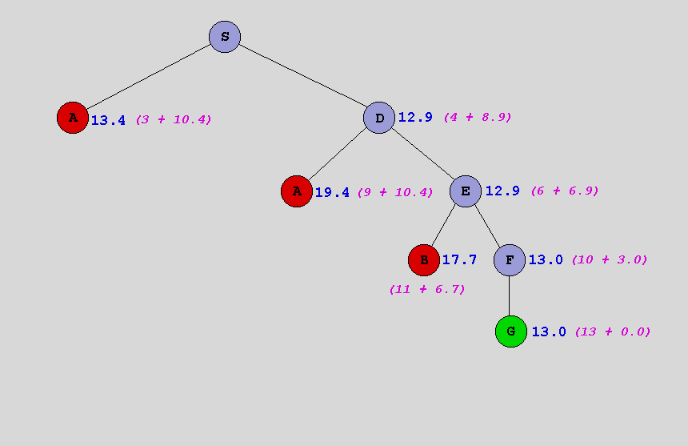
A* Search
f(n)=g(n)+h(n)
[S₀]
[D_{12.9},A_{13.4}]
[E_{12.9},A_{13.4},A_{19.4}]
[F_{13.0},A_{13.4},B_{17.7},A_{19.4}]
[G_{13.0},A_{13.4},B_{17.7},A_{19.4}]
A*={S,D,E,F,G}
Numbers under characters indicate (distances from S + distances to G).

Slide 59
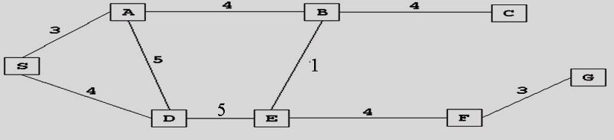
A* Search
S 11+0
SA A 10.4+3 | SD D 8.9+4
SA A 10.4+3 | SDS S 11+8 | SDA A 10.4+9 | SDE E 6.9+9
SDS S 11+8 | SDA A 10.4+9 | SDE E 6.9+9 | SAS S 11+6 | SAD D 8.9+8 | SAB B 6.7+7
SDS S 11+8 | SDA A 10.4+9 | SDE E 6.9+9 | SAS S 11+6 | SAD D 8.9+8 | SABA A 10.4+11 | SABE E 6.9+8 | SABC C 4+11
SDS S 11+8 | SDA A 10.4+9 | SDE E 6.9+9 | SAS S 11+6 | SAD D 8.9+8 | SABA A 10.4+11 | SABC C 4+11 | SABED D 8.9+13 | SABEB B 6.7+9 | SABEF F 3+12
SDS S 11+8 | SDA A 10.4+9 | SDE E 6.9+9 | SAS S 11+6 | SAD D 8.9+8 | SABA A 10.4+11 | SABED D 8.9+13 | SABEB B 6.7+9 | SABEF F 3+12 | SABCB B 6.7+15
SDS S 11+8 | SDA A 10.4+9 | SDE E 6.9+9 | SAS S 11+6 | SAD D 8.9+8 | SABA A 10.4+11 | SABCB B 6.7+15 | SABED D 8.9+13 | SABEB B 6.7+9 | SABEFE E 6.9+16 | SABEFG G 0+15

Slide 60
AIMA Python
aima-python github hesabından edin https://github.com/aimacode/aima-python
derleme için uygun Python versiyonu: Python 3.7.1 ve Jupyter ortamı gerekir.
Visual Studio Code veya PyCharm benzeri bir IDE edin
Anaconda kurulumunu yap
aima-data veri klasörünü ayrıca indirip aima-python içerisine ekle
aima-data için https://github.com/aimacode/aima-data/tree/f6cbea61ad0c21c6b7be826d17af5a8d3a7c2c86
Ortamı şu komut ile oluştur: conda create -n bmb3015 python=3.7
Ortamı kontrol et: conda info --envs
Ortamı aktifleştir: conda activate bmb3015
Ortama aşağıdaki paketleri verilen komutlarla kur
// ile verilen yorumları hariç tut
Paketlerin kurulup kurulmadığını kontrol et: conda list
Notes:
cvxopt conda install -c conda-forge cvxopt
image conda install -c slobodan image //version_incompatible
ipython conda install -c anaconda ipython
ipythonblocks conda install -c ryan ipythonblocks //notfound
ipythonblocks conda install -c bencpeters ipythonblocks //notfound
ipythonblocks conda install -c bce ipythonblocks //notfound
ipythonblocks pip install ipythonblocks==1.0
ipywidgets conda install -c anaconda ipywidgets
jupyter conda install -c anaconda jupyter
keras conda install -c conda-forge keras
matplotlib conda install -c conda-forge matplotlib
networkx conda install -c anaconda networkx
numpy conda install -c anaconda numpy
opencv-python conda install -c conda-forge opencv
pandas conda install -c anaconda pandas
pillow conda install -c anaconda pillow
pytest-cov conda install -c conda-forge pytest-cov
qpsolvers conda install -c conda-forge qpsolvers
scipy conda install -c anaconda scipy
sortedcontainers conda install -c conda-forge sortedcontainers
tensorflow conda install -c conda-forge tensorflow

Slide 61
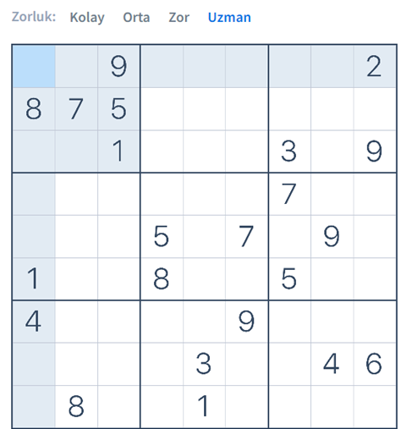
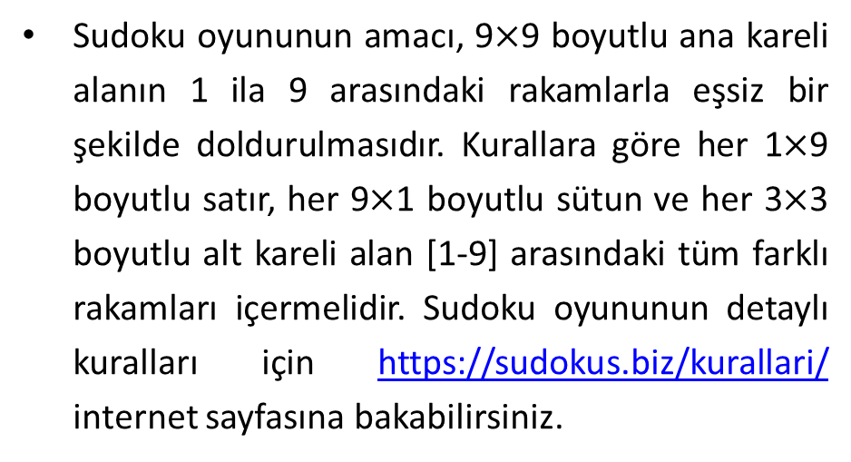
Homework I
Sudoku oyununun amacı, 9$×$9 boyutlu ana kareli alanın 1 ila 9 arasındaki rakamlarla eşsiz bir şekilde doldurulmasıdır. Kurallara göre her 1$×$9 boyutlu satır, her 9$×$1 boyutlu sütun ve her 3$×$3 boyutlu alt kareli alan [1-9] arasındaki tüm farklı rakamları içermelidir. Sudoku oyununun detaylı kuralları için https://sudokus.biz/kurallari/ internet sayfasına bakabilirsiniz.
Başlangıç durumu şekilde verilen Sudoku problemini A* programlama yaklaşımını kullanarak çözümleyiniz.
A* algoritması ile çevrimdışı aramada bulunan çözüm başlangıçtan hedefe bir yol olacaktır.
Yerel arama (kestirim) yaklaşımlarından genetik algoritmalar da bu problemin çözümü için kullanılabilirdi.
Ödevde genetik algoritma çözümü kodlanmayacak olsa da bu slaytın açıklama kısmına bakınız.
Notes:
Genetik algoritma ile bulunan çözüm yalnızca hedef durumun kendisini ifade edecektir. Problemi genetik algoritma ile çözecek olsaydık şunlar göz önüne alınmalıdır.
Yerel arama algoritmaları en uygun yolu her adımda yapılabilecek hareketleri değerlendirerek değil probleme çözüm olabilecek bazı temsiller üzerinde arama yaparak bulmaya çalışır. Dolayısıyla, problemin genetik algoritma çözümü için uzunluğu 9$×$9 ile ifade edilmiş olan olası çözümler (kromozomlar) oluşturulacaktır. Bir grup kromozom (popülasyon) içerisindeki herhangi bir kromozomu tasarlarken 9$×$9 uzunluklu [1-9] arası rakamlar başlangıç durumuna göre belirlenmiş bir kalıba uygun olarak seçilmelidir. Örneğin bir Sudoku problemi için bir kromozom başlangıç durumundaki rakamlar sabit tutularak şu genlerle oluşturulabilir. Koyu renkli rakamlar başlangıç durumunda verilenleri ifade etmektedir.
8 7 5 4 2 3 9 1 6 2 3 4 5 1 9 6 8 7 7 1 2 3 8 4 6 5 4 6 7 5 1 2 3 3 9 5 1 8 5 4 2 3 7 2 6 8 4 5 6 2 2 8 1 6 7 6 8 4 2 3 4 3 6 7 1 5 8 4 3 1 6 2 9 8 5 4 2 7 5 3 7
Rasgele oluşturulan bu çözümler problemin kurallarına uygun olmayacaktır. Dolayısıyla bir uygunluk fonksiyonu kullanılarak her bir kromozomun çözüm olarak değeri hesaplanmalıdır. Bu fonksiyonda her bir genin herhangi bir kuralı bozma (veya bozmama) sayısı toplamı üzerinden bir formül geliştirilebilir. Bir sonraki neslin türetilmesinde çaprazlama uygulanırken yine başlangıç durumunun sabit kalmasına çaprazlamanın diğer genler üzerinde çeşitli çaprazlama teknikleri kullanılarak yönetilmesine dikkat edilmelidir. Mutasyonun da düşük olasılıkla değiştirilebilir genler üzerinden yapılması sağlanmalıdır. Hedefe ilk kaçıncı iterasyonda (jenerasyonda) varıldığı algoritmanın başarısını belirleyecektir. Yeterli bir iterasyon sonucunda hala hedefe varılamamışsa en uygun çözüm dönülecektir.

Slide 62
Homework I (Devam)
Hazırlayacağınız ödev raporunda,
Sudoku oynayan ajan için PEAS tanımını, ortam özelliklerinin sınıflandırılmasını ve farklı ajan tiplerine göre ajan tasarımını gerçekleştiriniz.
Problemin durum, hedef fonksiyonu, ardıl fonksiyonu, bedel (değer) fonksiyonu veya sezgi fonksiyonu tanımlarını gerçekleştiriniz.
Sezgi fonksiyonunun tanımıyla problemin kısıtlarına uygun bir şekilde belirlenecek olan bedelleri düğümlere ekleyiniz.
Hedef fonksiyonunun problemin kurallarını kontrol eden alt fonksiyonlar üzerinden çalışmasını sağlayınız.
Detaylı bilgi için bu slaytın açıklama kısmına bakınız.
A* ile hedefe ulaşılıp ulaşılamadığını ve ulaşıldıysa kaç adımda ulaşıldığını değerlendiriniz.
Zaman ve uzay karmaşası analizi
A* ile bulunan çözümün oyunun kurallarını sağlayıp sağlamadığını ve en uygun çözüm olup olmadığını analiz ediniz.
Bütünlük ve uygunluk
Yazdığınız kodu IDE’de göründüğü kalitede kopyalayınız.
Ekran çıktısındansa aynı font tipinde ve düşük font boyutunda kopyala yapıştır ile.
Ajanın oynadığı oyuna dair bulduğu çözümün konsol veya grafik arayüz ekran çıktısını ekleyiniz.
Notes:
Problemin A* algoritması ile çözümü için kapalı durumlar listesi (closed list veya visited list) tutan bir çizge arama (graph search) algoritması programlanacaktır. A* algoritmasının en uygun yolu en az hamlede bulabilmesi için anlamlı sezgiler ve bedeller belirlenip bir değerlendirme fonksiyonu türetilecektir. Başlangıç durumundan (initial state) başlanıp her seferinde mevcut konumda gerçekleştirilebilecek tüm olası hareketler değerlendirilerek hedefe ulaşıp ulaşmama koşulu kontrol edilecektir. Bir hamle neticesinde eğer bir kural ihlali ile karşılaşılıyorsa o zaman o hamle için herhangi bir çocuk kenar listesi (fringe) içerisine yerleştirilmeyebilir veya yüksek bir sezgi bedeli kullanılarak düğümün gezilmesinin ertelenmesi sağlanabilir.
04_Informed search ders notunun son 2 slaytına bakınız.
Ödev teslim raporunuza
kodunuzun çıktısını
kısaca yöntem, analiz ve yorumlarınızı
okunaklı bir şekilde kaynak kodunuzu
eklemeniz gerekmektedir.

